Slide 1
What’s in a Chemical Entity?
Heng Ji (UIUC & Amazon Scholar)
hengji@illinois.edu
Work done by: Hongwei Wang, Carl Edwards, Zixuan Zhang, Tuan Lai, Chenkai Sun, Weijiang Li (UIUC)
Co-advised by: Jiawei Han (UIUC) and Kyunghyun Cho (NYU)

Slide 2
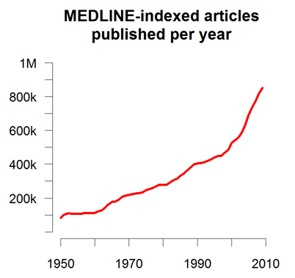
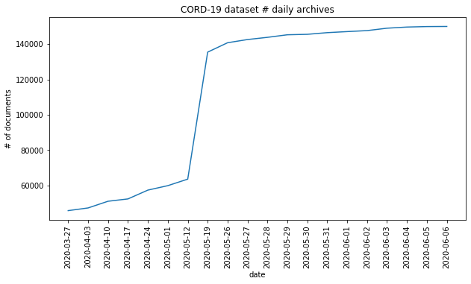
Problem: Too Much papers
More than 500K papers are published at PubMed every year, and more than 1.2 million new papers are published in 2016 alone, bringing the total number of papers to over 26 million (Van Noorden, 2014)
As of June 13, 2020, there are at least 140K papers about coronavirus
Quality: Given the rapid publications of preprints without peer reviews, many research results are redundant, complementary or even conflicting with each other
Human’s reading ability keeps almost the same across years: US scientists estimated that they read, on average, only 264 papers per year (1 out of 5000 available papers, the same across years)
Notes:
300 papers… every day… impossible to read… keyword search… abstract doesn’t reflect… results; ignore most of them. Cancer and surgery… 3 days… walk through all posters.. In our field papers that were published twenty years ago are not that important…
including mining PubMed bibliographic data, research papers in PubMed, clinical data sets and numerous bio-medical websites and social media related to medical sciences, where data related to diseases, drugs, treatments, chemical compounds, proteins, genes, biological pathways can be integrated and extracted from text data and their characteristics and relationships can be mined from such datasets as well
. Older literature is often extremely important (and overlooked), and indeed, often provides a rich source of information that can lead to new hypotheses. This makes the information overload problem event more serious, because we need distill and connect knowledge from papers that may cover 70 years.

Slide 3
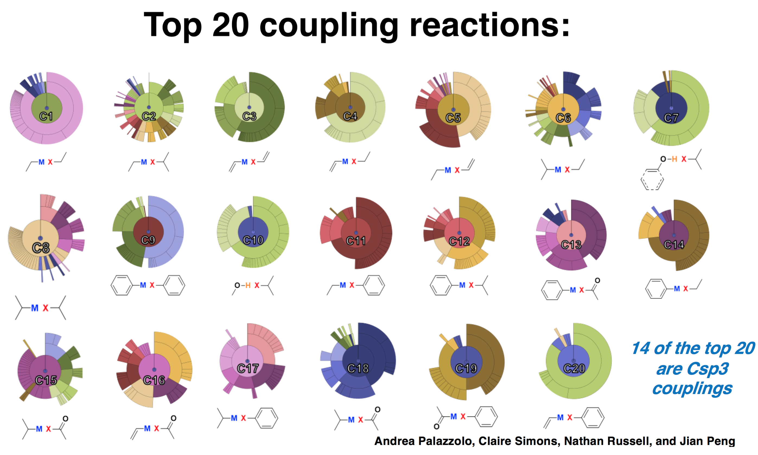
How modern Chemists design their experiments
Most of the current scientific experiments are still based on manual design and candidate ranking
E.g., Top 20 candidates manually selected from thousands of candidates
BioNLP shared tasks mainly cover biomedical papers, but very limited papers are about chemistry
Notes:
To tackle these two challenges, we propose a new framework COVID-KG to accelerate scientific discovery and build a bridge between clinicians and biology scientists.
COVID-KG starts by reading existing papers to build multimedia knowledge graphs (KGs), in which nodes are entities/concepts and edges represent relations and events involving these entities, extracted from both text and images.
Given the knowledge graphs enriched with path ranking and evidence mining, COVID-KG answers natural language questions effectively.
Our system has several contributions.
Firstly, we use new distantly supervised, refined fine-grained extraction and typing to help Knowledge Graph construction.
Secondly, we use chemical graph parsing and image analysis to enable multi-media common semantic space construction and new hierarchical embedding for graph neural networks-based knowledge extraction and entity resolution.
The third innovation is that we adopt Domain-specific ontology and database guided knowledge enrichment for joint neural end-to-end entity/relation/event extraction; Our COVID’19 Knowledge graph receives more than 500downloads
We also apply Generative Adversarial Networks for data augmentation by regarding samples generated by the generator as negative samples to train the discriminator
Finally, we adopt Weakly-supervised automated taxonomy construction, and taxonomy-guided, theme-based multidimensional document classification and text summarization

Slide 4
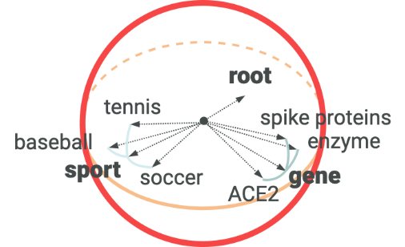
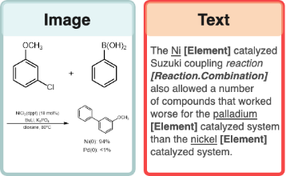
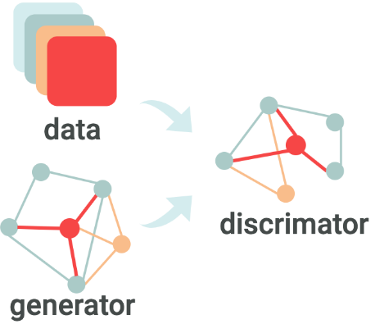
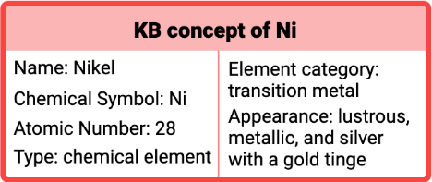

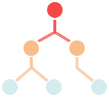
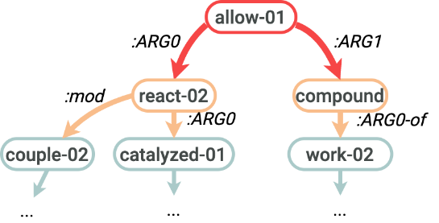

Our GOAL: converting unstructured DATA TO structured KNOWLEDGE
DATA
SEMANTICS
KNOWLEDGE BASE
Graph neural networks
Joint entity/relation/event extraction and ontology construction
Hierarchical Spherical Embedding
Scientific Literature
Multimedia Knowledge Base
Ontology Enriched Text Embedding
Generative Adversarial Networks for Data Augmentation and Distant Supervision
Chemical Ontology & Existing Databases
Cross-media Structured Semantic Representation
Multimedia Search and Summarization
Notes:
To tackle these two challenges, we propose a new framework COVID-KG to accelerate scientific discovery and build a bridge between clinicians and biology scientists.
COVID-KG starts by reading existing papers to build multimedia knowledge graphs (KGs), in which nodes are entities/concepts and edges represent relations and events involving these entities, extracted from both text and images.
Given the knowledge graphs enriched with path ranking and evidence mining, COVID-KG answers natural language questions effectively.
Our system has several contributions.
Firstly, we use new distantly supervised, refined fine-grained extraction and typing to help Knowledge Graph construction.
Secondly, we use chemical graph parsing and image analysis to enable multi-media common semantic space construction and new hierarchical embedding for graph neural networks-based knowledge extraction and entity resolution.
The third innovation is that we adopt Domain-specific ontology and database guided knowledge enrichment for joint neural end-to-end entity/relation/event extraction; Our COVID’19 Knowledge graph receives more than 500downloads
We also apply Generative Adversarial Networks for data augmentation by regarding samples generated by the generator as negative samples to train the discriminator
Finally, we adopt Weakly-supervised automated taxonomy construction, and taxonomy-guided, theme-based multidimensional document classification and text summarization

Slide 5
Unique challenges and solutions
Developed multimodal definition powered entity representation
2-D images of molecules, representing the underlying molecules or reactions
text-based molecule descriptors
chemical graph structure from 480K reactions
natural language definition and description
structured properties in external databases
Incorporate external knowledge via entity linking
Capture complex sentence structures
AMR parsing and graph neural networks
Applications
Reaction and property prediction
Natural language to chemical entity retrieval
Entity graph to sequence description generation
Experiment procedure schema induction

Slide 6
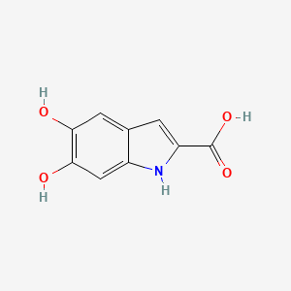
5,6-Dihydroxy-1H-indole-2-carboxylic acid
WHAT’S in a chemical entity?
Natural Language Definition: 5,6-dihydroxyindole-2-carboxylic acid is a dihydroxyindole that is indole-2-carboxylic acid substituted by hydroxy groups at positions 5 and 6. It has a role as a mouse metabolite. It is a conjugate acid of a 5,6-dihydroxyindole-2-carboxylate. It is a tautomer of a dopachrome.
Natural Language Context: Tautomerization of dopachrome to 5,6-dihydroxyindole-2-carboxylic acid (DHICA) is a biologically crucial reaction relevant to melanin synthesis, cellular antioxidation, and cross-talk among epidermal cells.
Chemical entity mentions are essentially rare terms that cannot be learned well by only language model
Chemical entities are often complex formula-like names (e.g., 5,6-dihydroxycyclohexa-1,3-diene-1-carboxylic acid)
Many chemicals simply have never been coined with any nomenclature in natural language

Slide 7
5,6-Dihydroxy-1H-indole-2-carboxylic acid
Property Name | Property Value
Molecular Weight | 193.16
XLogP3-AA | 1.2
Hydrogen Bond Donor Count | 4
Hydrogen Bond Acceptor Count | 4
Rotatable Bond Count | 1
Exact Mass | 193.03750770
Monoisotopic Mass | 193.03750770
Topological Polar Surface Area | 93.6 Å²
Heavy Atom Count | 14
Formal Charge | 0
Complexity | 245

Slide 8
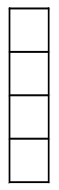
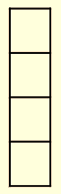
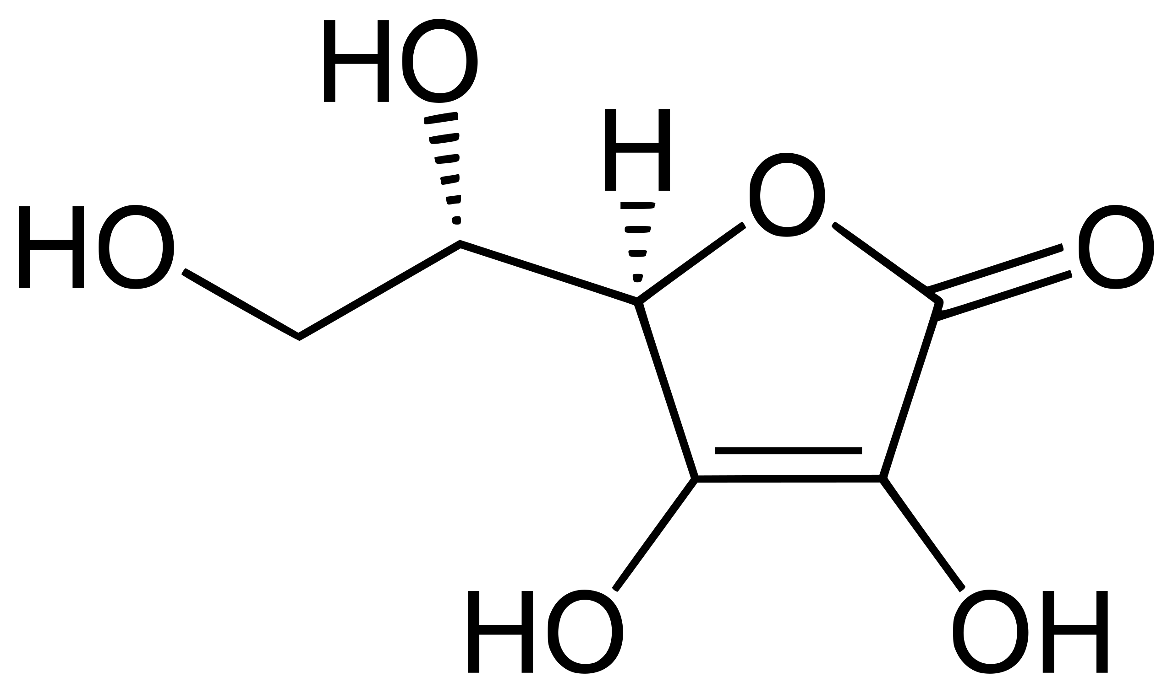
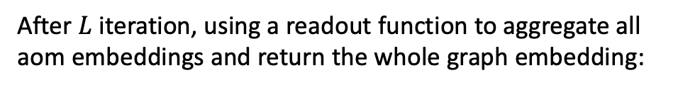
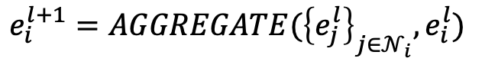
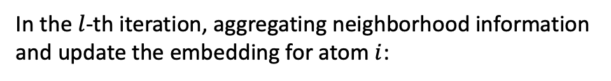
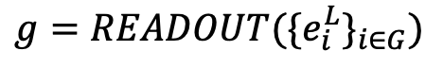
Structure-aware and reaction-aware chemical entity embedding representation
1. Propagating messages over the graph
2. Read out the molecule graph embedding
In the $l$-th iteration, aggregating neighborhood information and update the embedding for atom $i$:
After $L$ iteration, using a readout function to aggregate all aom embeddings and return the whole graph embedding:
$$e_{i}^{l+1}=AGGREGATE({\left\{e_{j}^{l}\right\}}_{j∈𝒩_{i}},e_{i}^{l})$$
$$g=READOUT({\{e_{i}^{L}\}}_{i∈G})$$

Slide 9
Structure-aware and reaction-aware chemical entity embedding representation
Structure- and reaction-aware molecule embeddings
Acetaldehyde
Acetic acid
$$y$$
$$O_{2}$$
$$CH_{3}COOH$$
$$CH_{3}CHO$$
$$O$$
$$x$$

Slide 10
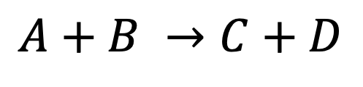
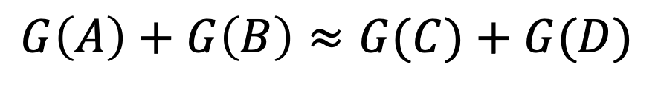
Structure-aware and reaction-aware chemical entity embedding representation
Chemical reaction space:
$$A+B →C+D$$
Molecule embedding space:
$$G\left(A\right)+G\left(B\right)≈G(C)+G(D)$$
G: the molecule graph encoder

Slide 11
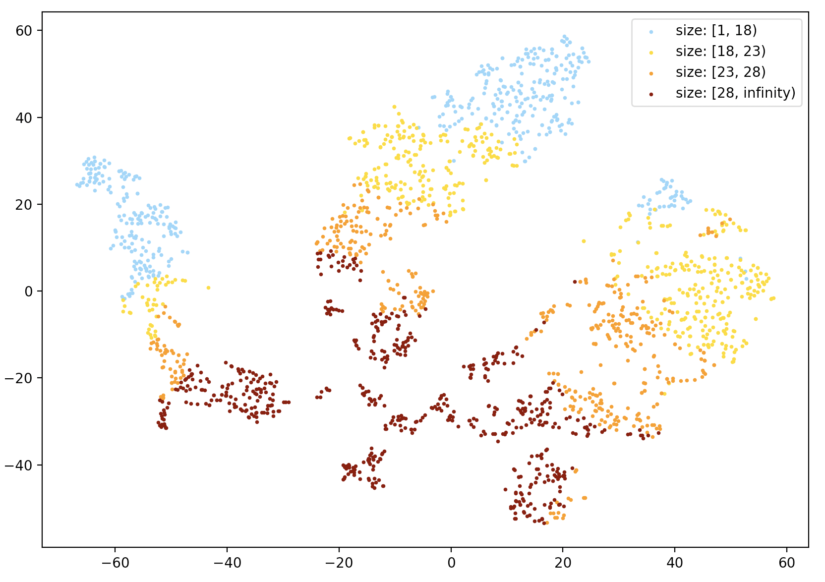
Embedding visualization
Molecule sizes (# heavy atoms) for BBBP dataset
Small-molecule region
Size increasing
Large-molecule region

Slide 12
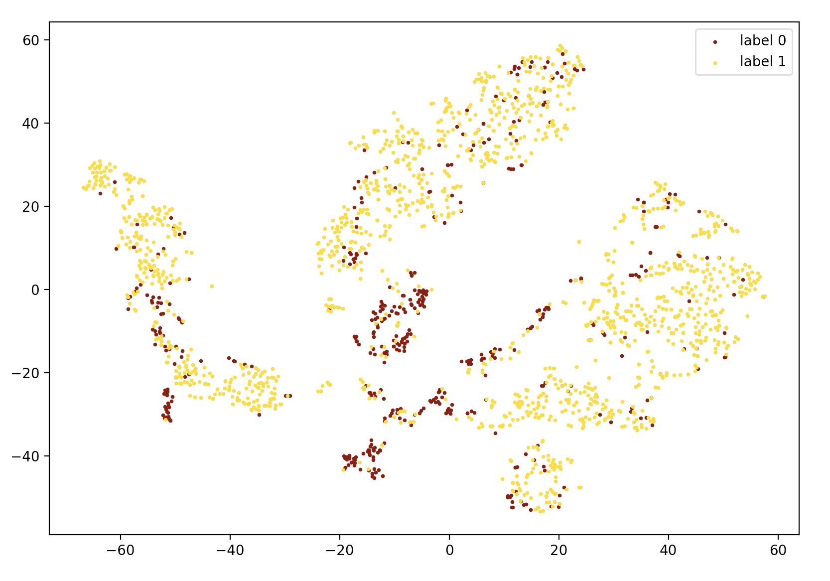
Embedding visualization
Molecule property p_np (permeable or not) for BBBP dataset
Clusters of non-permeable molecules

Slide 13
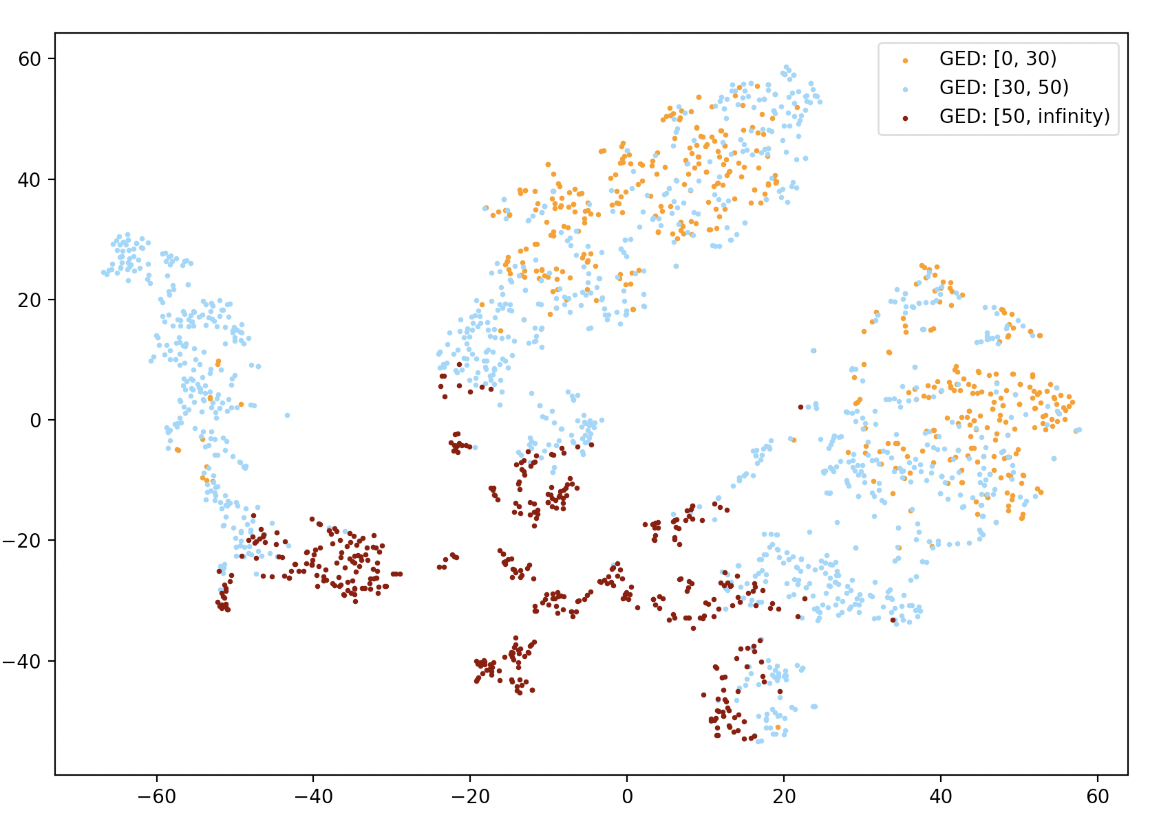
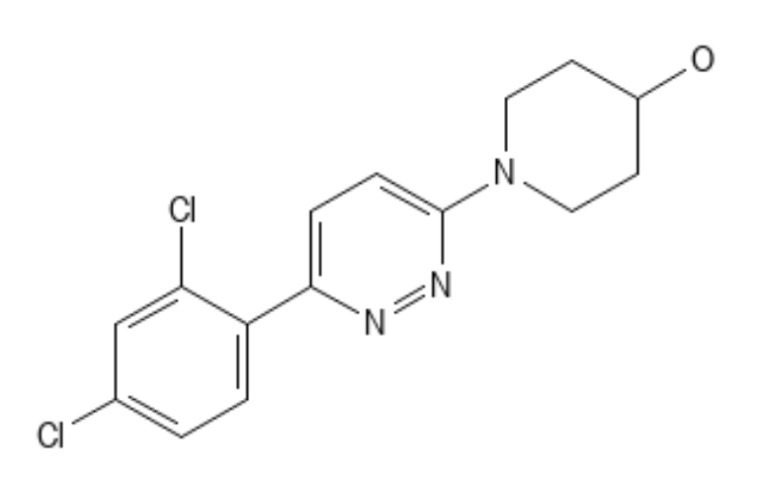
Embedding visualization
GED w.r.t. to #1196 molecule in BBBP dataset
Molecules that are structurally similar to #1196 are also close to it in embedding space
# 1196 molecule in BBBP
Molecules that are structurally dissimilar to #1196 are also far from it in embedding space

Slide 14
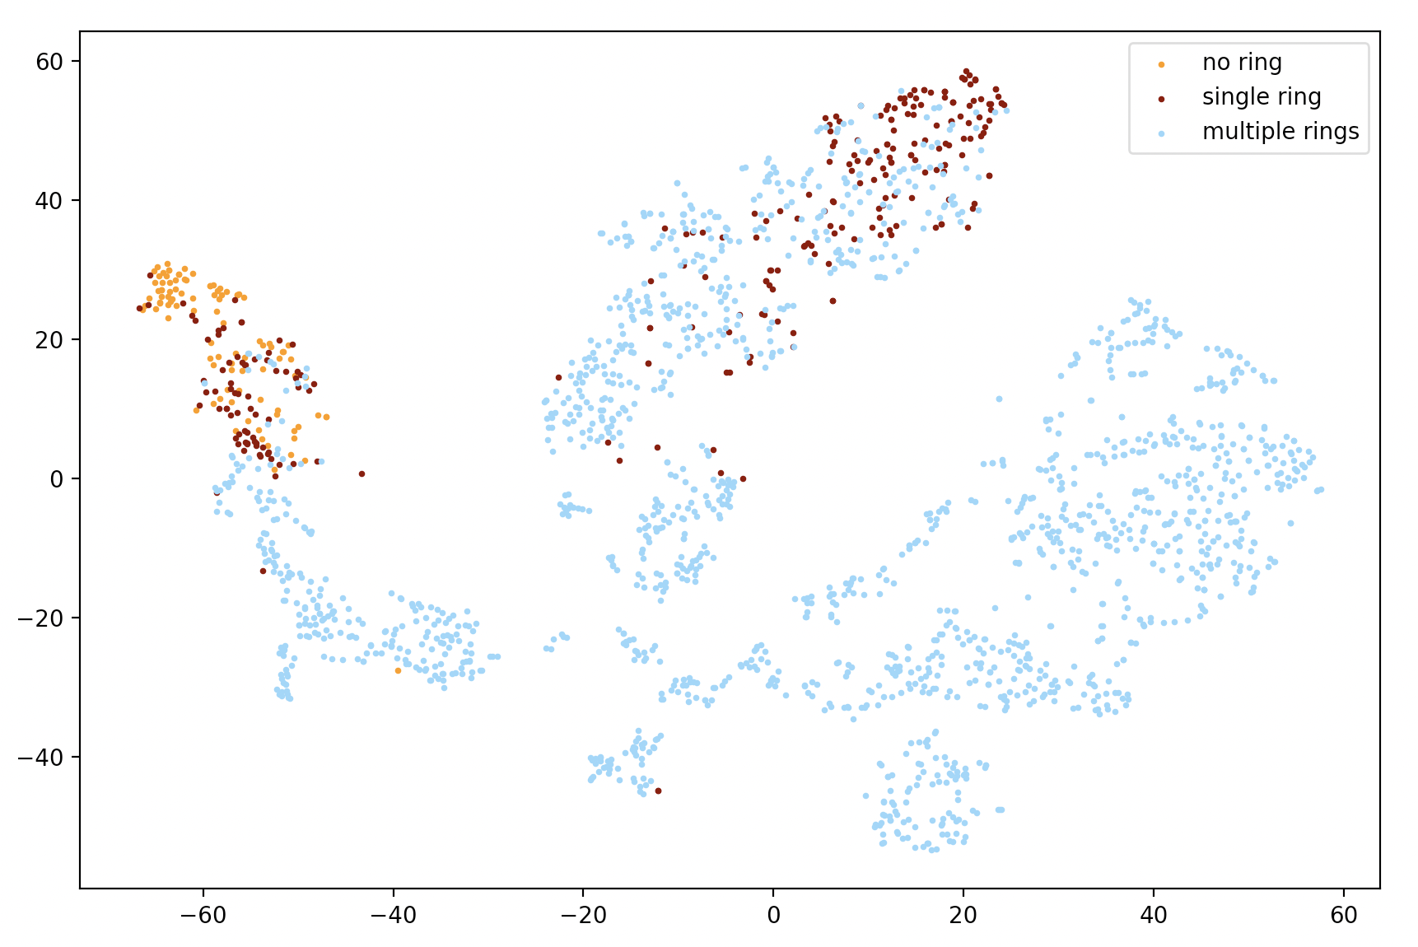
Embedding visualization
# smallest rings for BBBP dataset
# rings increasing
Cluster of molecules with no ring
Cluster of molecules with one ring

Slide 15
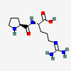
Adding cross-modal attention to improve interpretability
Negative Sampling Loss
MLP
Cross-modal Attention
Transformer Decoder
Mean Pooling
SciBERT
GCN
Mol2vec Token Features
Adjacency Matrix
Description Tokens

Slide 16
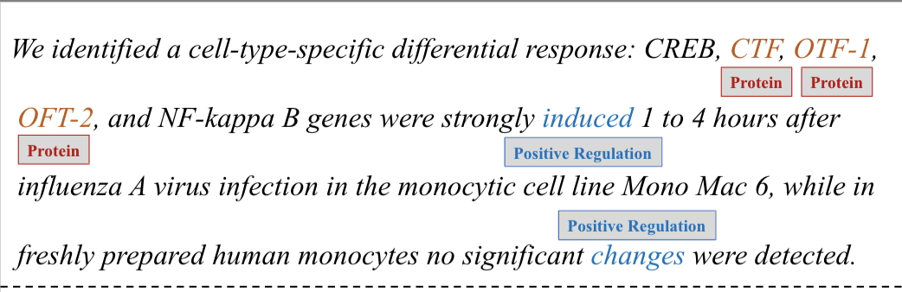
Sentence-level context is insufficient
Most of the scientific concepts are abbreviated without explicit explanations of their meanings.
The complex biomedical and chemical interactions between multifarious chemicals, genes, and proteins are even harder to understand.

Slide 17
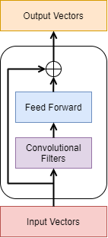
EFFICIENT Entity Linking BASED ON CNN
A simple model that mainly focuses on capturing local interactions may perform as well as SOTA BERT-based models.
A natural candidate that exhibits the desired properties is the convolutional neural network (CNN) architecture.
Our encoding layer consists of several encoding blocks.
Each encoding block has multiple convolutional filters of varying window sizes.
We also employ a position-wise fully connected feed-forward network after the convolutional filters.
There is a residual connection between the input and output of each encoding block
An illustration of an encoding block

Slide 18
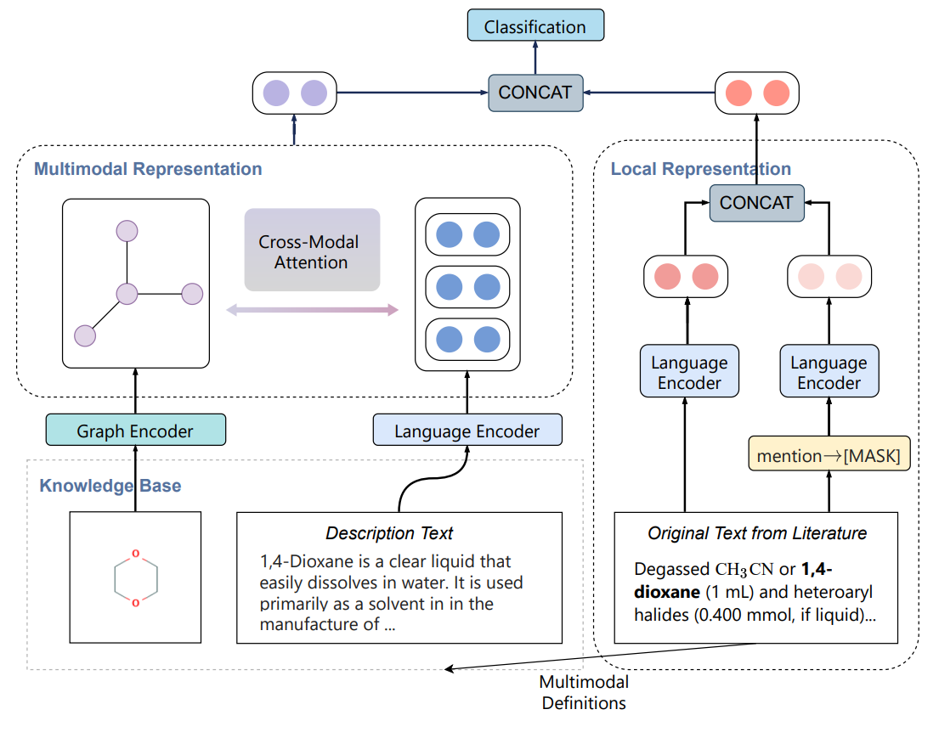
multimodal definition powered entity representation
Utilize multimodal definition of chemicals (chemical structure, natural language description)
Incorporate cross-modal attention to align substructures to concepts in natural language description for interactions across different modalities

Slide 19
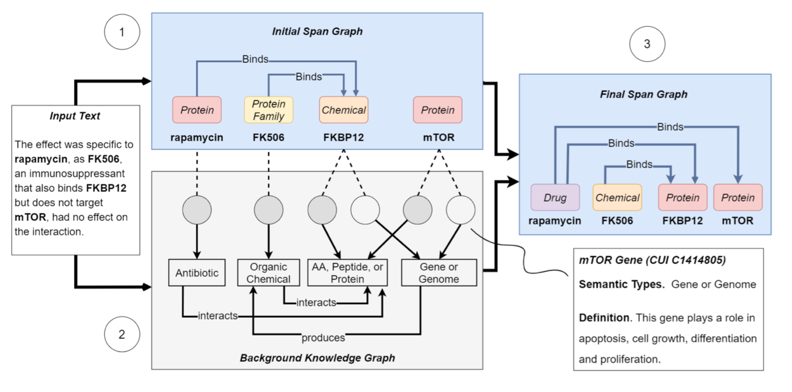
Constructing an Extra Brain: Encoding External Knowledge via entity linking
(Lai et al., ACL2021)
Notes:
KECI operates in three main steps:
Build an initial span graph representing KECI’s initial understanding of the text.
Use an entity linker to build a background knowledge graph containing all potentially relevant biomedical entities from an external KB.
Align the node of the two graphs to make final predictions of entities and relations.

Slide 20
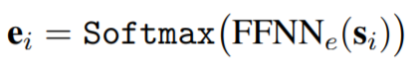
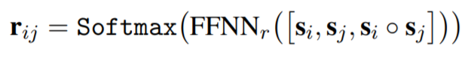
Initial Span graph construction
Enumerate all the spans up to a certain length and computes a representation for each span.
Predict the type of each span and the relation between each span pair jointly.
The predictions are then used to construct an initial span graph
Use a bidirectional graph convolutional network (GCN) to integrate initial relational information into each span representation

Slide 21
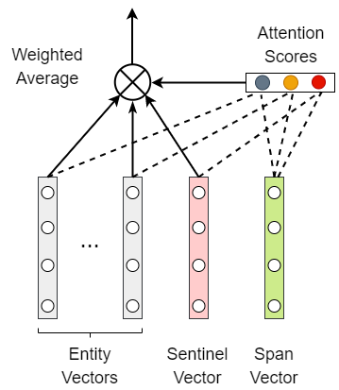
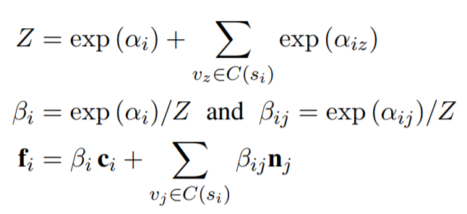
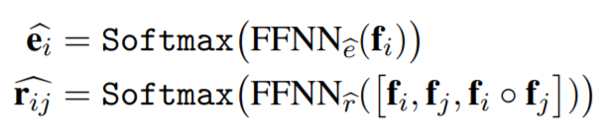
Final Span graph prediction
After building the two graphs, we soft-align the mentions and the candidate entities using an attention mechanism.
With the extracted knowledge-aware span representations, we predict the final span gr

Slide 22
Long distance between knowledge elements
Paper authors tend to write long sentences with clauses and appositions for better presentations.
Example: Foxp3[Argument] contains a proline-rich amino-terminal domain reported to function as a nuclear factor of activated T cells (NF-AT) and nuclear factor-kappaB (NF-kappaB) binding domain, a central region containing a zinc finger and leucine zipper potentially important for protein-protein interactions, and a carboxyl-terminal forkhead (FKH) domain required for nuclear localization[Trigger] and DNA-binding activity [14-16] .
Distance between event trigger and argument:
Dataset | Average Distance | Maximal Distance
ACE05-E (News) | 0.212 sentence | 56 words
GENIA-2011 (Papers) | 0.330 sentence | 77 words

Slide 23
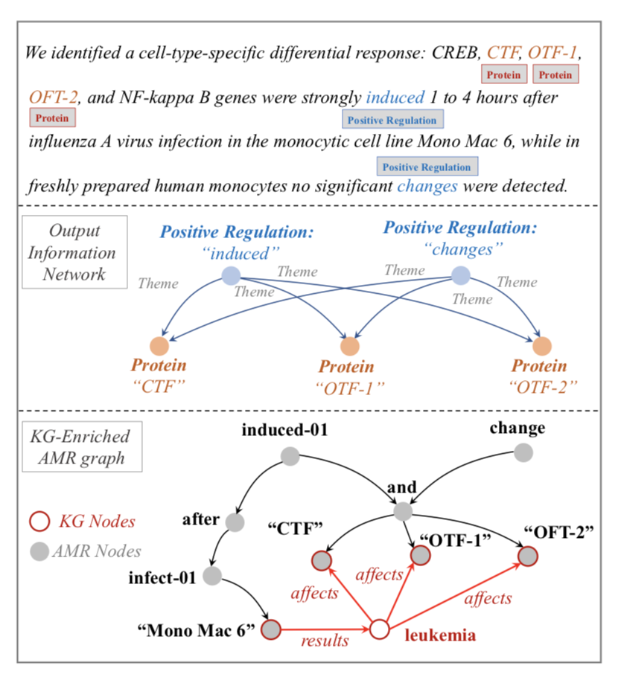
Compressing Long Context with Abstract Meaning Representation
Use BioBERT as the sentence encoder, and adopt span enumeration and classification for identifying event triggers and entities
Message passing using an edge-conditioned graph attention network
Jointly training and inference (trigger and arguments) for biomedical event extraction

Slide 24
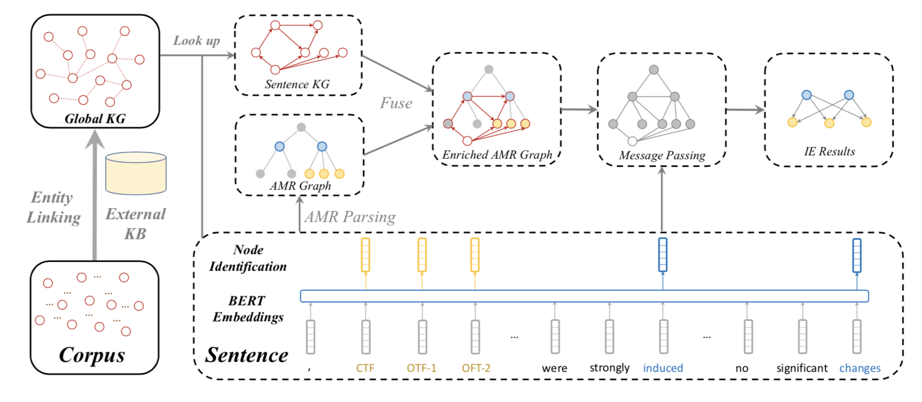
Knowledge-enriched Abstract Meaning Representation

Slide 25
ENTITY AND RELATION EXTRACTION Results
BioRelEx dataset – detecting binding interactions between proteins and/or biomolecules
ADE dataset – extracting drug-related adverse effects
 | Entity (Macro-F1) | Relation (Macro-F1)
Relation-Metric (Tran et al. 2019) | 87.11 | 77.29
SpBERT (Eberts et al. 2020) | 89.28 | 78.84
Span_{Multi-Head} (Ji et al. 2020) | 90.59 | 80.73
KnowBertAttention (Baseline) | 90.08 | 79.95
KECI (Ours) | 90.67 | 81.74
 | Entity (Micro-F1) | Relation (Micro-F1)
SciIE (Luan et al. 2018) | 73.56 | 50.15
Second Best Model | 82.76 | 62.18
KECI (Ours) | 87.35 | 67.09
Overall results (%) on the BioRelEx leaderboard
Overall results (%) on the ADE dataset

Slide 26
Event EXTRACTION Results
GENIA2011 (interaction between proteins and biomolecules)
Extracting biomedical events (9 types) and proteins
Data Split | Train Set | Dev Set | Test Set
# Documents | 908 | 259 | 231
# Sentences | 8,620 | 2,846 | 3,348
# Proteins | 11,625 | 4,690 | 5,301
# Events | 10,310 | 3,250 | 4,487
Model | Prec | Rec | F1
String Matching | 43.92 | 21.82 | 29.16
Tree LSTM | 67.01 | 52.14 | 58.65
GEANet | 64.61 | 56.11 | 60.06
BEESL | 69.72 | 53.00 | 60.22
DeepEM | 71.71 | 56.20 | 63.02
Bert-Flat | 64.68 | 52.98 | 58.25
BERT-AMR | 68.39 | 53.58 | 60.09
BERT-AMR-KG | 72.74 | 55.62 | 63.04

Slide 27
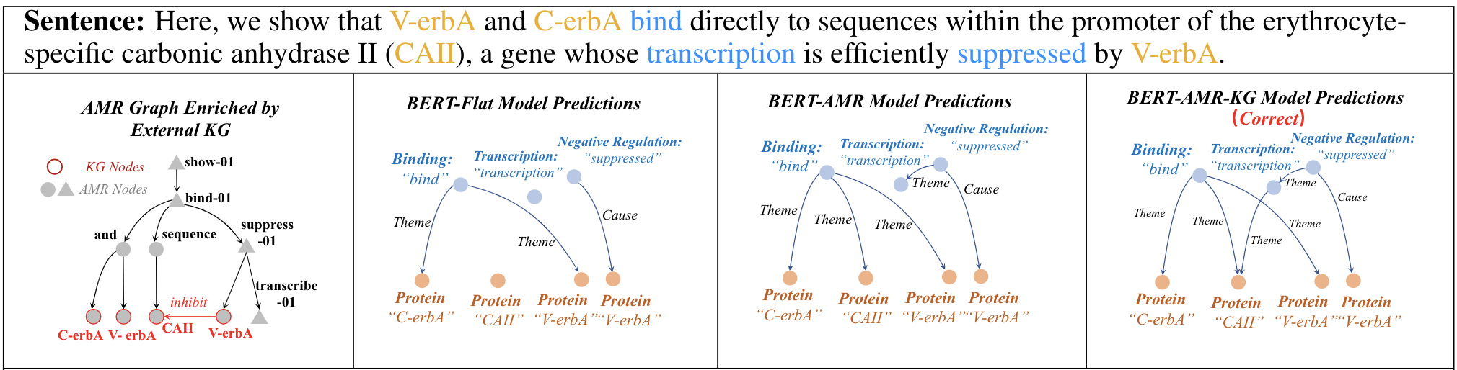
Qualitative analysis
Explanation #1: AMR helps to link the trigger “bind” to entity “CAII” although they are located far away from each other in the sentence.
Explanation #2: External KG helps to recognize “CAII” as the theme of “transcription” based on the additional KG link in the enriched AMR graph.

Slide 28
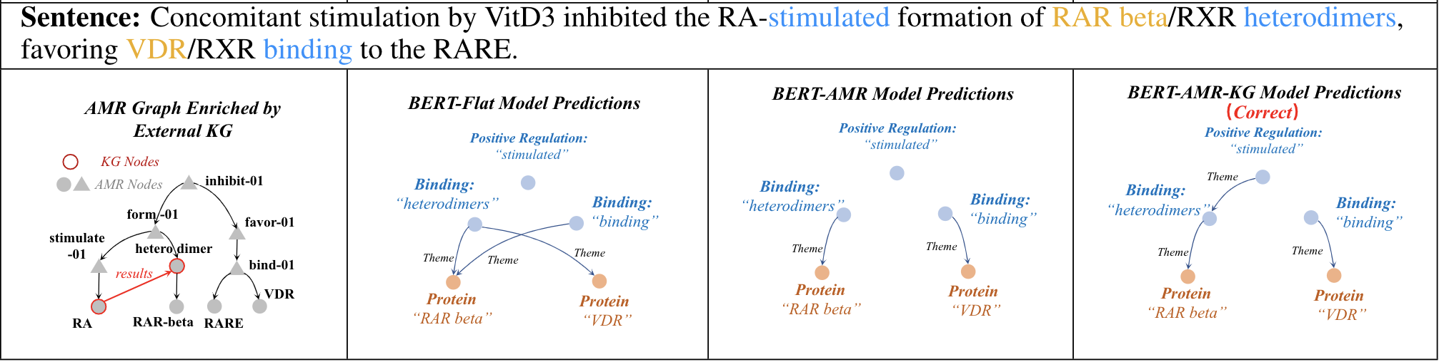
Qualitative analysis
Explanation #1: AMR helps to guide the model to find the correct arguments for the two binding events in the sentence.
Explanation #2: External KG helps to identify the positive regulation effect on the generation of heterodimers.

Slide 29
APPLICATION [1]: REACTION AND PROPERTY PREDICTION
Dataset: USPTO (training size: ~480k, valid & test size: ~40k)
Transform SMILES to graphs
Node features include: element ID, charge, whether in an aromatic ring, number of neighboring Hydrogen atoms
No edge feature (order of bonds) is considered
Use GNN to encode a molecule graph into a vector
Graph convolutional networks
dgl.nn.GATConv() -> Graph attention networks
dgl.nn.SAGEConv() -> Graph sampling and aggregation networks
dgl.nn.TAGConv() -> Topology-aware GCN
dgl.nn.SGConv() -> Simplified GCN

Slide 30
Training
Dataset = ([r1, p1], [r2, p2], …), where r and p are reactant graph embeddings and product graph embeddings
Only minimizing the distance between [ri, pi] is not enough
All embeddings will become zero after training
Introducing negative samples for each reactant graph

Slide 31
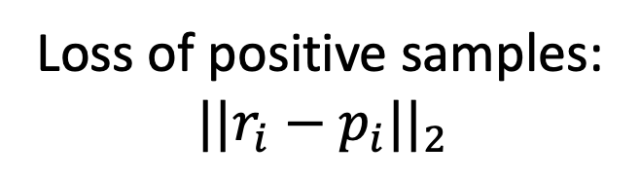
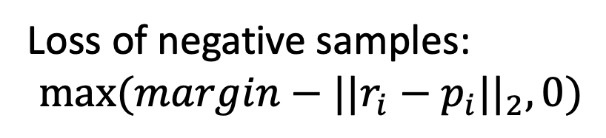
Training: contrastive loss
For a minibatch of data: ([r1, p1], [r2, p2], …, [rn, pn])
p1
p2
pn
Loss of positive samples:
$${||r_{i}−p_{i}||}_{2}$$
r1
r2
Loss of negative samples:
$$max⁡(margin−{||r_{i}−p_{i}||}_{2},0)$$
Total loss of a minibatch = mean of positive loss + mean of negative loss
rn

Slide 32
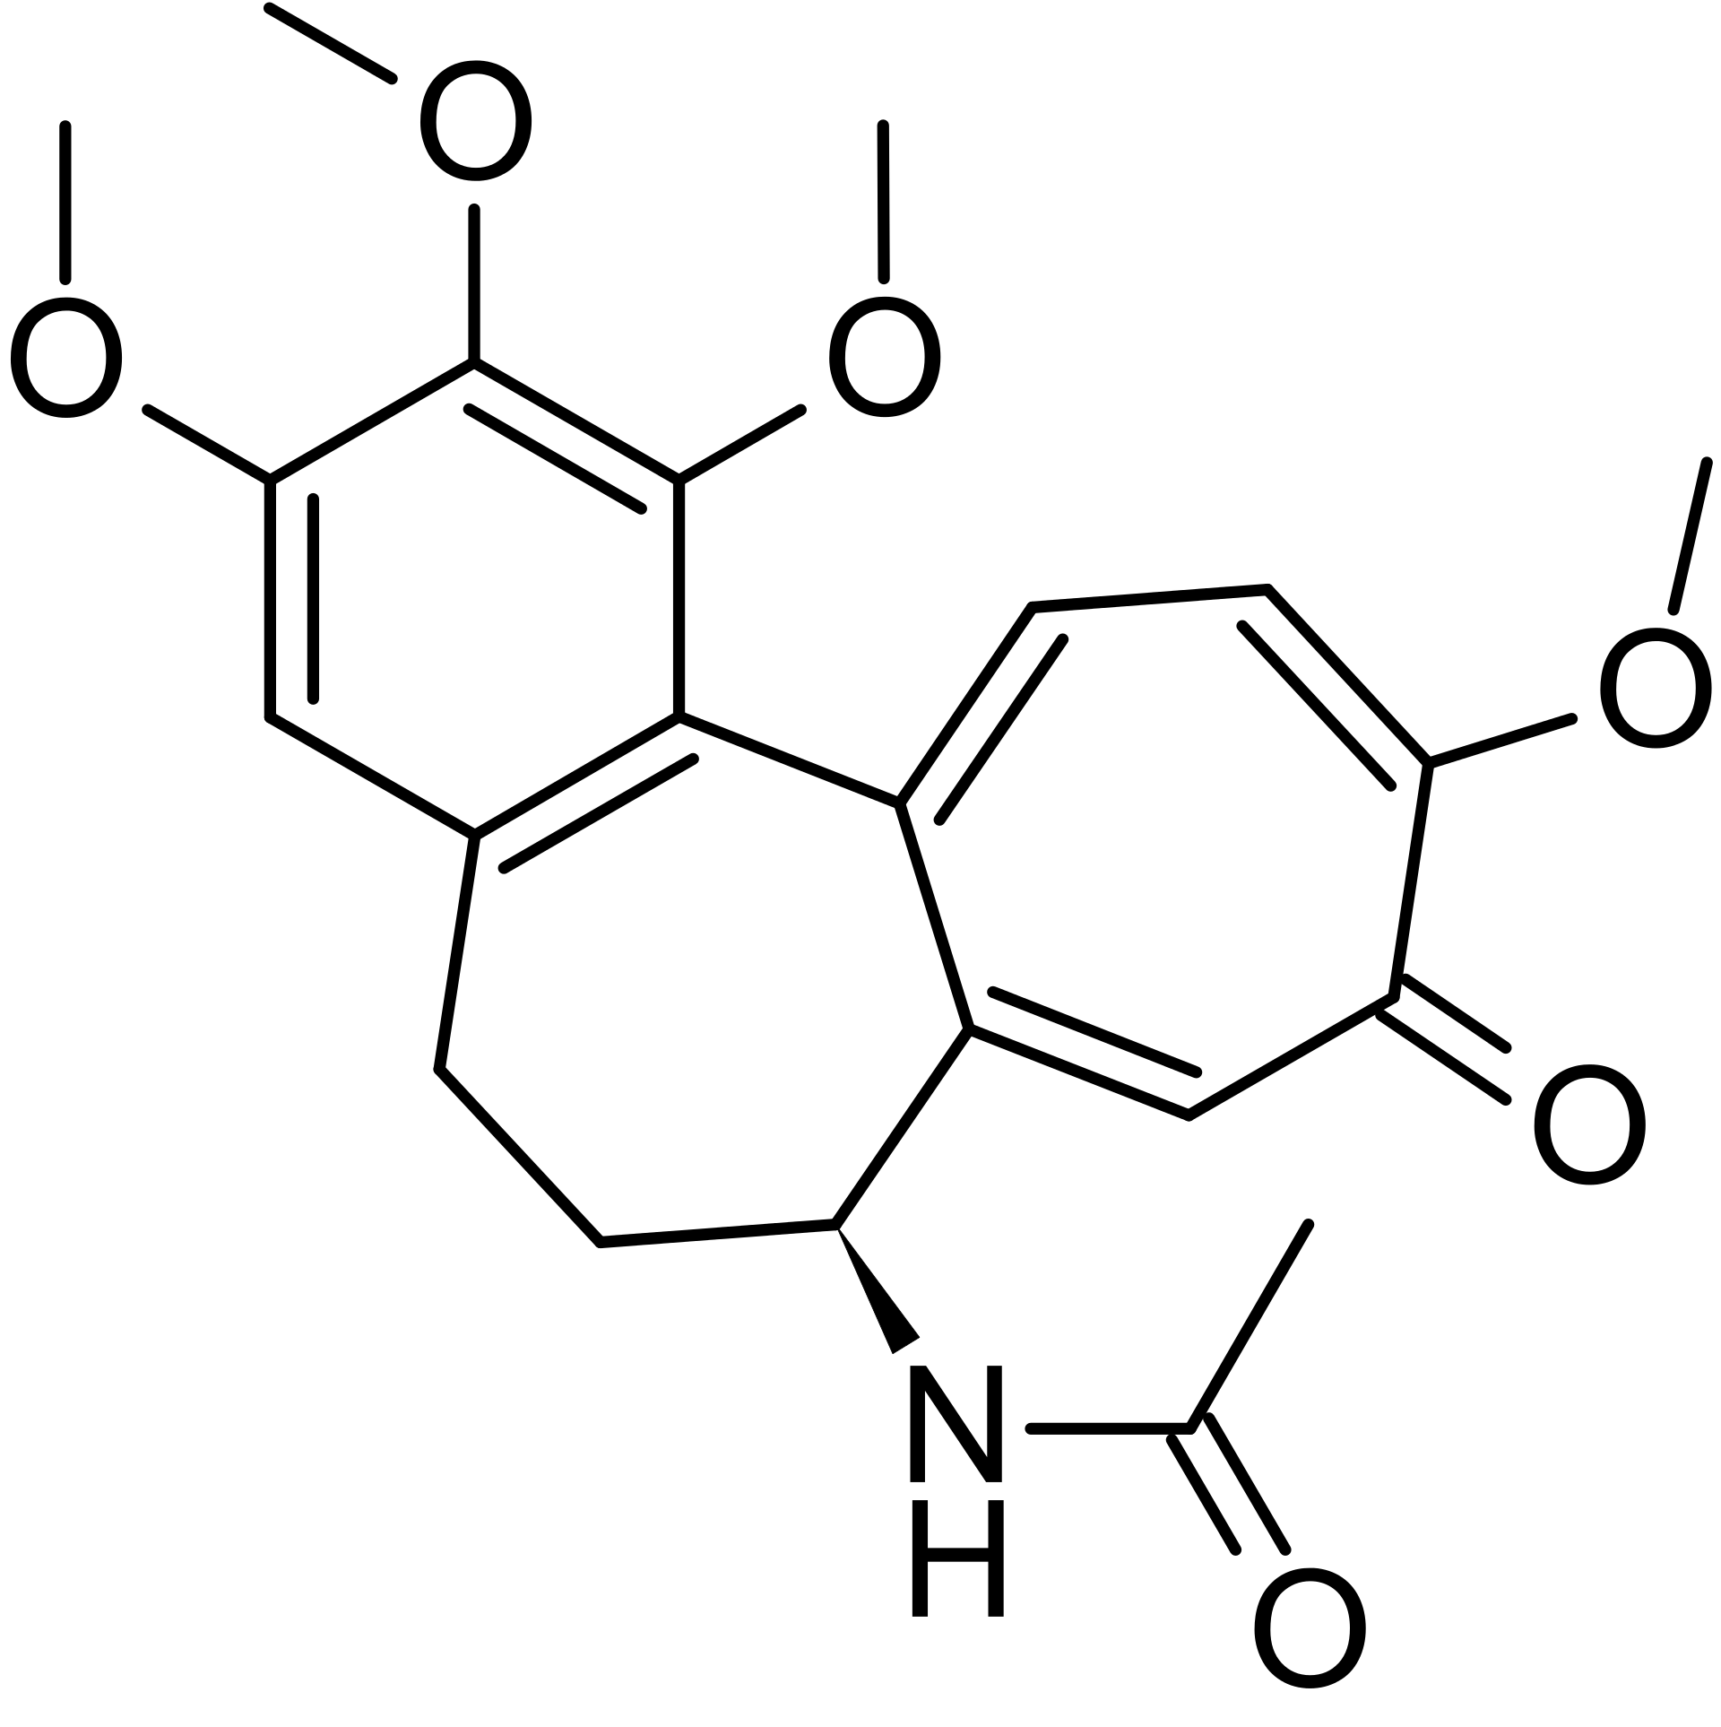
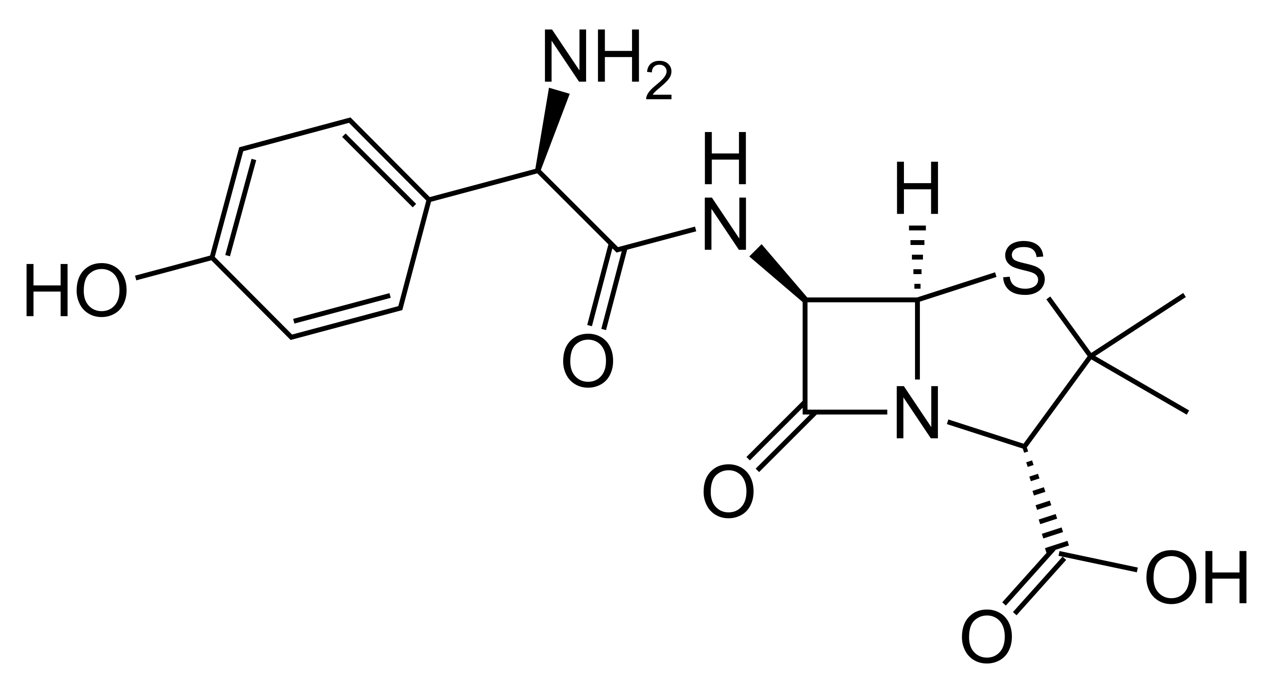
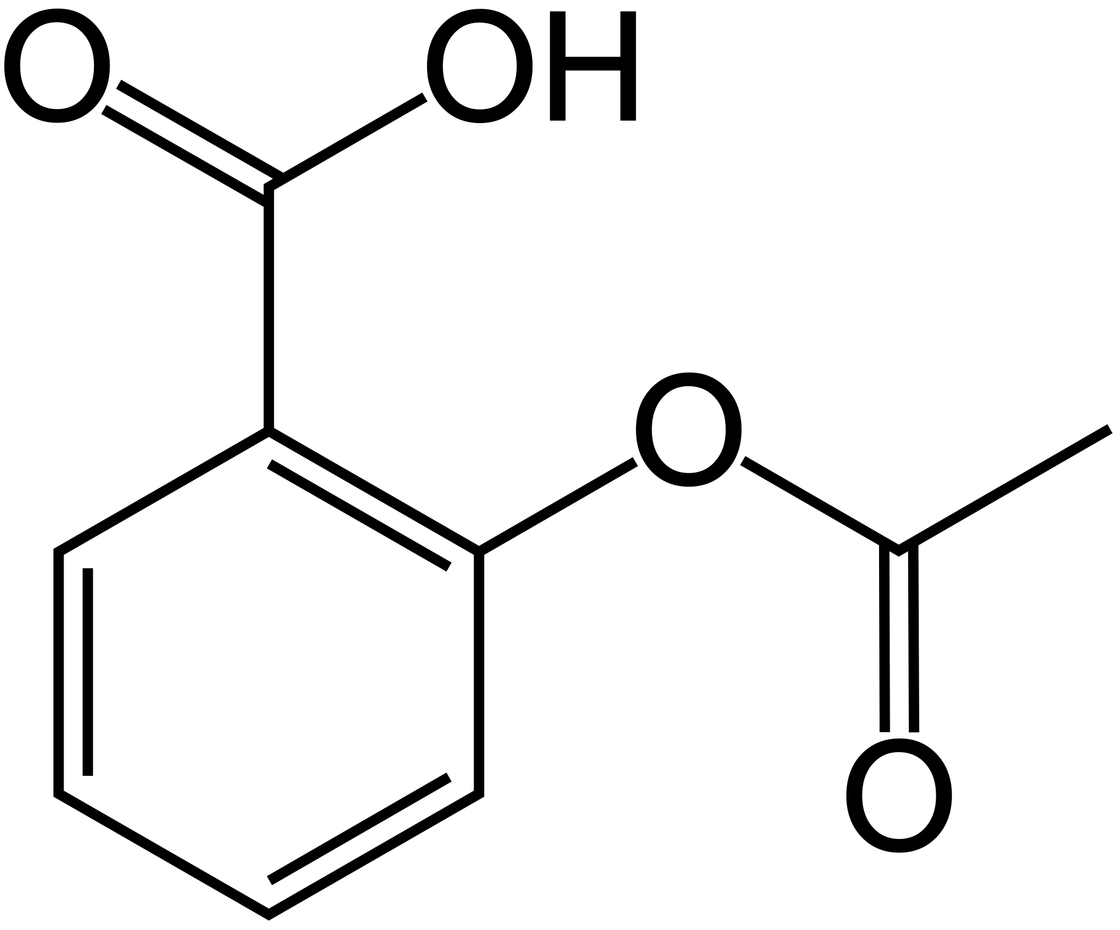
Reaction prediction
Query reactant(s)
Candidate products
Trained model
Trained model
Query emb
[candidate emb1, candidate emb2, …]
Calculating Euclidean distance and ranking candidates

Slide 33
Reaction prediction Results
Using molecules in train, validation, and test sets as candidates
#training: 408,673, #validation: 29,973, # test: 39,966
 | MRR | MR | Hit@1 | Hit@3 | Hit@5 | Hit@10
Ours-GCN | 0.728 | 390.4 | 0.612 | 0.826 | 0.870 | 0.908
Ours-GAT | 0.714 | 409.4 | 0.593 | 0.816 | 0.862 | 0.902
Ours-SAGE | 0.711 | 599.2 | 0.589 | 0.814 | 0.861 | 0.901
Ours-TAG | 0.746 | 335.4 | 0.633 | 0.843 | 0.885 | 0.920
Ours-SGC | 0.341 | 5289.4 | 0.252 | 0.390 | 0.441 | 0.503
Mol2vec (w/o finetune) | 0.469 | 5768.8 | 0.369 | 0.532 | 0.587 | 0.650
Mol2vec (finetune) | 0.473 | 4979.5 | 0.371 | 0.536 | 0.592 | 0.658
MolBERT (w/o finetune) | 0.114 | 2588.7 | 0.055 | 0.131 | 0.172 | 0.229
MolBERT (finetune) | 0.122 | 1874.6 | 0.058 | 0.139 | 0.185 | 0.248

Slide 34

Property prediction
All molecules in a dataset
Pretrained model
[candidate emb1, candidate emb2, …]
Classification or regression ML models (SVM, decision tree…)

Slide 35
Property prediction
 | BBBP | HIV | BACE
Task type | Classification | Classification | Classification
# molecules | 2050 | 41127 | 1513
Targets to be predicted (Using GCN as baseline):
BBBP: Binary labels of blood-brain barrier penetration (permeability)
HIV: Experimentally measured abilities to inhibit HIV replication
BACE: Quantitative (IC50) and qualitative (binary label) binding results for a set of inhibitors of human β-secretase 1 (BACE-1)
 | BBBP | HIV | BACE
Ours-1024 | 0.891 | 0.815 | 0.889
Ours-768 | 0.892 | 0.789 | 0.871
Ours-300 | 0.901 | 0.761 | 0.870
Mol2vec-300 | 0.853 | 0.769 | 0.865
Molbert-768 | 0.874 | 0.779 | 0.862

Slide 36

APPLICATION [2] retrieving molecular images with natural language QUERIES
102,980 compound-description pairs from ChEBI annotations scraped from PubChem.
Created dataset, ChEBI-20, containing 33,010 pairs where descriptions have >20 words.
Rostratin D is an organic disulfide isolated from the whole broth of the marine-derived fungus Exserohilum rostratum and has been shown to exhibit antineoplastic activity. It has a role as a metabolite and an antineoplastic agent. It is a bridged compound, a cyclic ketone, a lactam, an organic disulfide, an organic heterohexacyclic compound, a secondary alcohol, a dithiol and a diol.

Slide 37
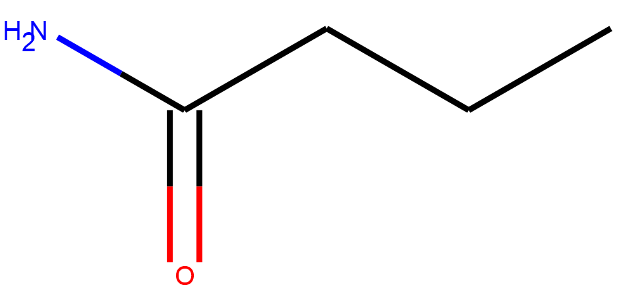
APPLICATION [2] retrieving molecular images with natural language QUERIES
Mol2vec corpus building
Contrastive Symmetric Loss
Outer product of molecule and text batch compared to identity matrix:
1572579716
1559650422
734603939
Cross-entropy Loss
-1100000244
1559650422
-1074141656
-932108170
Cross-entropy Loss
-1789102870
863188371
-1708545601
-1793471910
2099970318

Slide 38
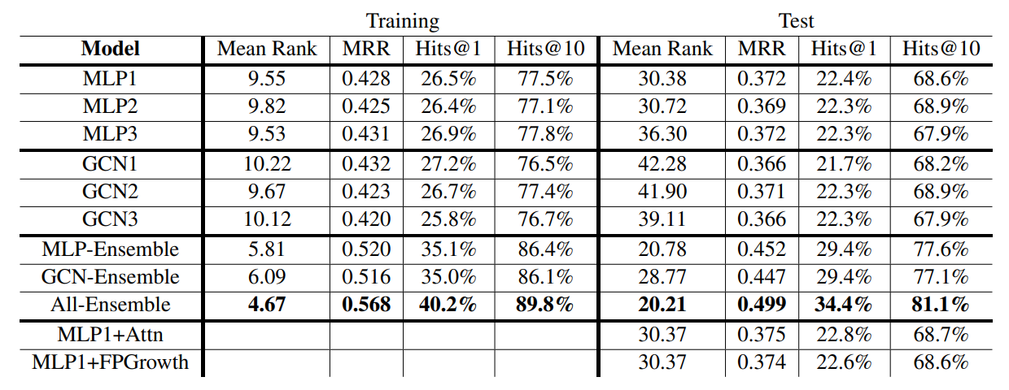
APPLICATION [2] retrieving molecular images with natural language QUERIES

Slide 39
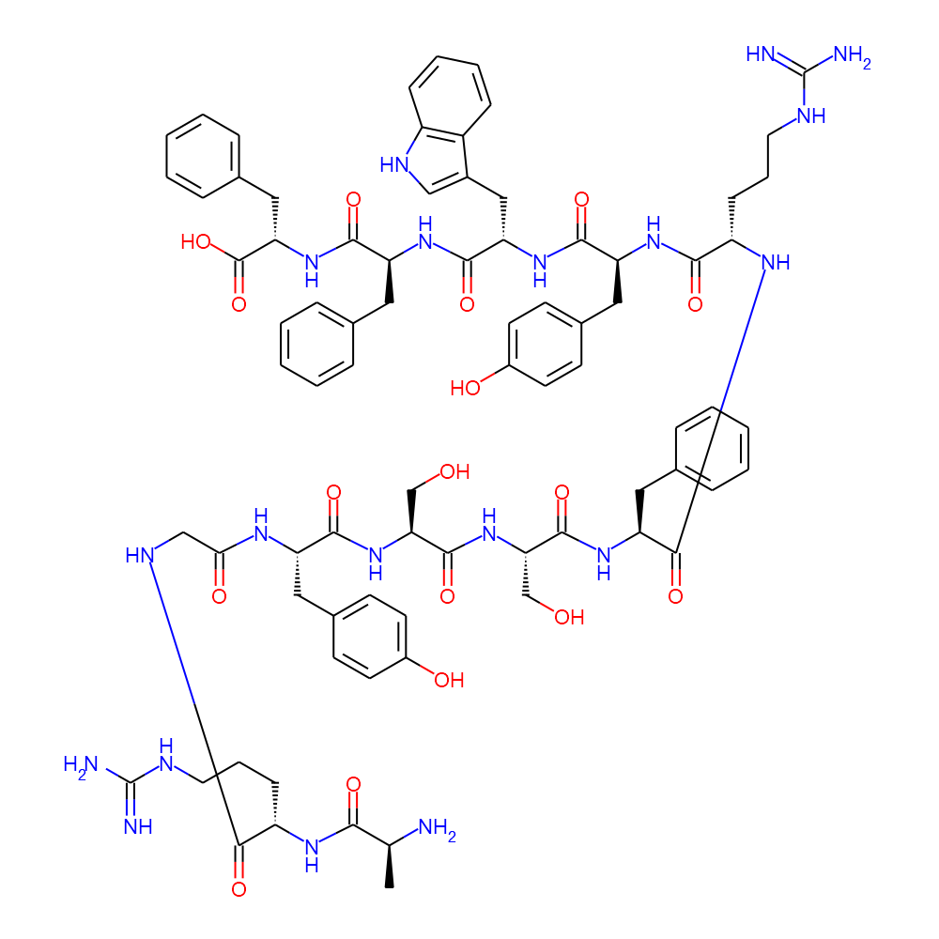
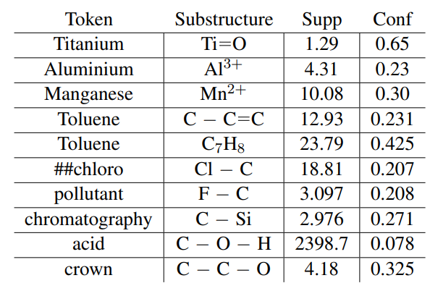
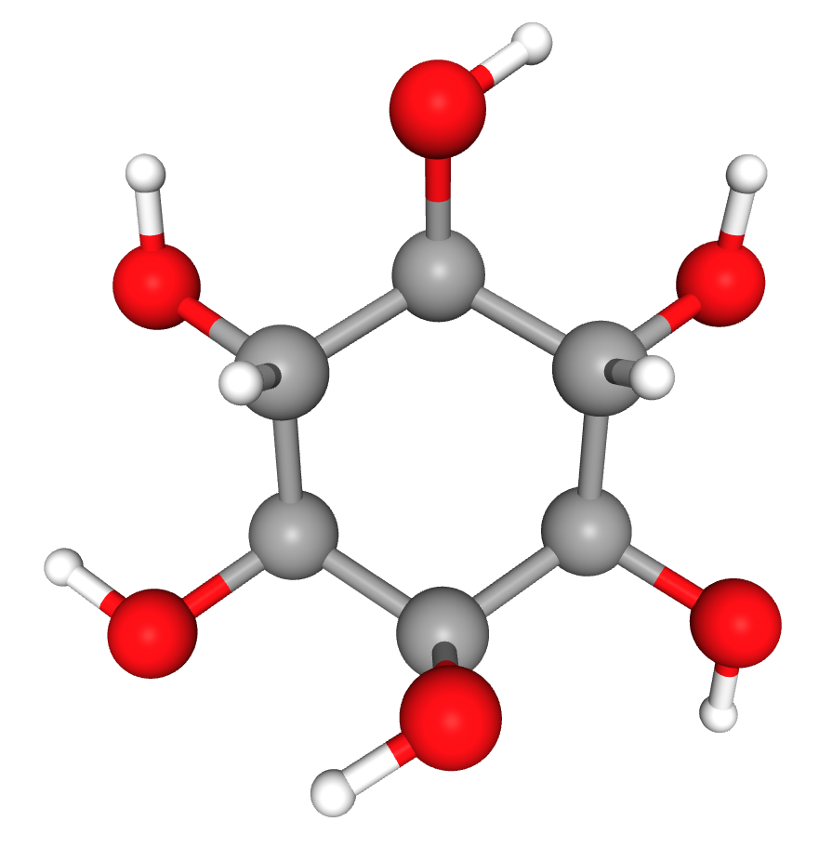
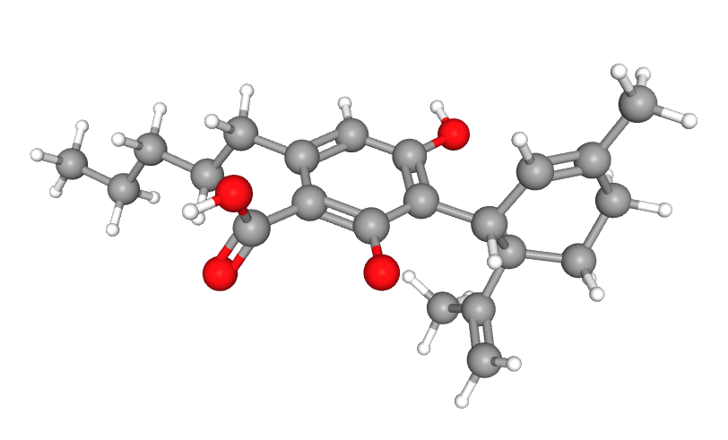
Examples from retrieval and cross-modal association rule mining
Correct Retrieval
Mined Association Rules
Argyssfrywff: Ala-Arg-Gly-Tyr-Ser-Ser-Phe-Arg-Tyr-Trp-Phe-Phe is an oligopeptide composed of L-alanine, L-arginine, glycine, L-tyrosine, L-serine, L-serine, L-phenylalanine, L-arginine, L-tyrosine, L-trytophan, L-phenylalanine and L-phenylalanine joined in sequence by peptide linkages.
Inositol: Myo-inositol is an inositol having myo- configuration. It has a role as a member of compatible osmolytes, a nutrient, an EC 3.1.4.11 (phosphoinositide phospholipase C) inhibitor, a human metabolite, a Daphnia magna metabolite, …
Cannabidiolate is a dihydroxybenzoate that is the conjugate base of cannabidiolic acid, obtained by deprotonation of the carboxy group. It derives from an olivetolate. It is a conjugate base of a cannabidiolic acid.

Slide 40
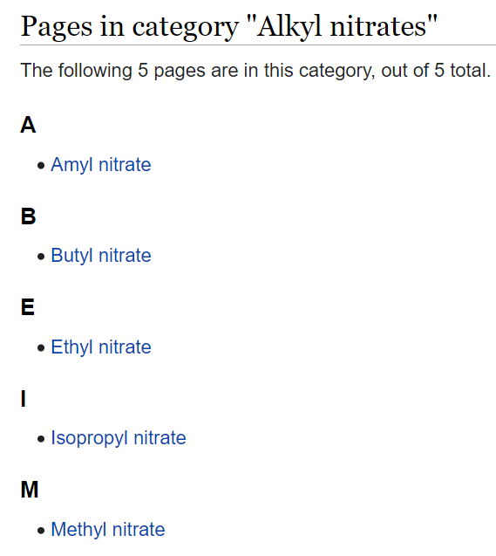



A NEW chemistry IE BENCHMARK
A new benchmark ChemET: includes 81 million molecules and 100 chemistry papers fully annotated with a new fine-grained Chemistry ontology
Data comes from PubChem open access literature
Developed a new entity ontology that includes 62 entity types (e.g., Chemistry→Organic Chemistry→OrganicCom-197pounds→Hydrocarbons→Other Hydrocarbons)
Developed a new Chemistry Event Ontology with 59 types about results, methods and procedures
Training set constructed by distant supervision (using Wikipedia page and PubChem synonyms)
Evaluation set annotated by chemistry students
Dataset Stats

Slide 41


A NeW COVID-19 Benchmark
http://blender.cs.illinois.edu/covid19/
Manually annotated 122 documents with 6,789 sentences in total
Data Sources:
AI2 CORD-19 archive: index for COVID-19 related papers from PubMed, PubMed Central, Arxiv, and Bio-Arxiv
NCBI PMC API: retrieve PubMed (PM) or PubMed Central (PMC) articles
NCBI Pubtator API: retrieve pre-annotated PubMed or Pubmed Central articles

Slide 42

APPLICATION IN COVID-19 DRUG REPURPOSING REPORT GENERATION
[Wang et al., NAACL2021 Best Demo Paper Award]

Slide 43


APPLICATION IN COVID-19 DRUG REPURPOSING REPORT GENERATION
Entity Grounding for Drug Molecular Structure Image
Figure 1.
FDA approved drugs of most interest for repurposing as potential Ebola virus treatments.
KG from caption text
FDA
approve
Multimedia Knowledge Graph Expansion
repurpose
Drugs
Ebola

Slide 44

Conclusions and Future Work
It’s time to apply our knowledge discovery techniques to help ourselves
Fine-grained Information Extraction is still the key to success and down-stream applications (prediction, question answering, summarization, generation, etc.)
Key bottleneck: how to work with domain experts effectively; learn to do error analysis; integrate symbolic domain knowledge with distributional semantic embedding representations, extend extraction to experiment procedural knowledge
44
Notes:
Change low resource IL to a language which is not in wikipedia
Word-level: from bi-lingual dicts and alignment; structure-level comes from wals; multi-level alignment

